Slide 1
Homework 1
Spring 2020

Slide 2

Problem
Given an undirected graph $G=(\{0,1,…,n−1\},E)$, determine whether it is connected.

Slide 3
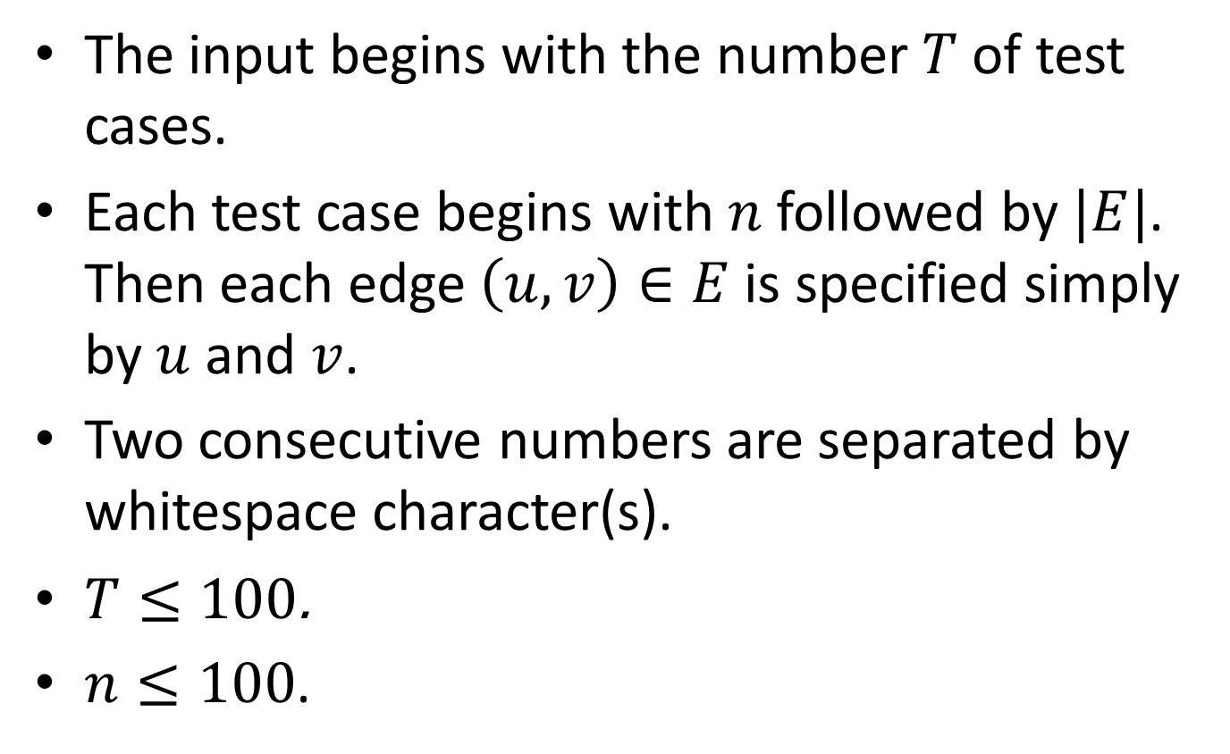
Input
The input begins with the number $T$ of test cases.
Each test case begins with $n$ followed by $|E|$. Then each edge $\left(u,v\right)∈E$ is specified simply by $u$ and $v$.
Two consecutive numbers are separated by whitespace character(s).
$T≤100$.
$n≤100$.

Slide 4

Output
For each test case, output “connected” in a line if $G$ is connected and “disconnected” otherwise.

Slide 5
Remark
Because I will test your program using diff, the outputs must be exactly in the specified format.

Slide 6
Sample input
3
3
2
0 1
2 0
4
3
0 3
2 3
2 0
4
5
0 3
2 3
2 0
1 3
2 1

Slide 7
Sample output
connected
disconnected
connected

Slide 8
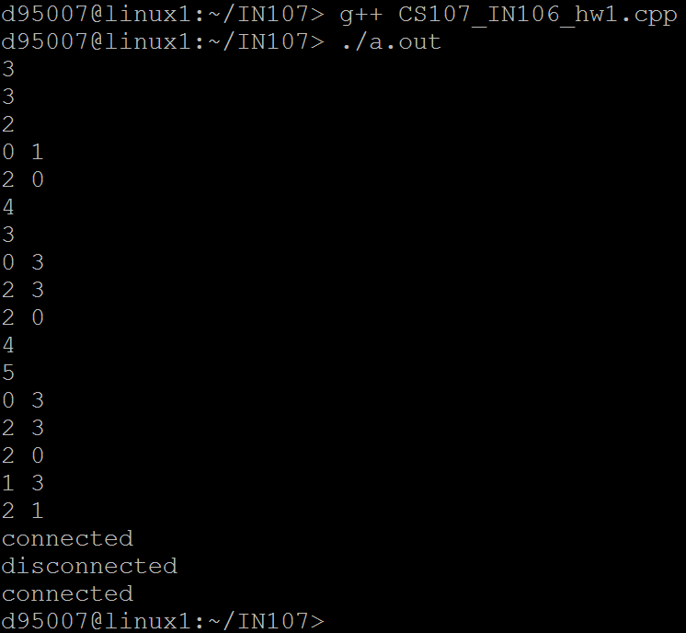
My program

Slide 9
Deadline
Deadline for the first version: Two weeks later
Deadline of revisions: The day of the final exam

